Slide 1



Predicting NBA All-Stars Through Data Mining
Ryan Raitz
Hunter Sullenberger

Slide 2

Abstract
Data Mining is a process commonly used to analyze data and generate models with predictive power based on that data. There is a litany of Data Mining software and tools to help us with calculations related to a large dataset, and the software we utilized in this project was WEKA, a data mining program originating from New Zealand. To provide an entertaining and practical application to Data Mining, we decided to focus on data relating to NBA All-Stars. The NBA All-Star draft is an annual event where the top players of each conference are voted on by fans to represent their entire conference in the annual NBA All-Star game. Our goal is to use and explain different data mining techniques to give a statistical definition to a player’s “popularity” relating to the NBA All-Star Draft. In other words, to prove that the NBA All-Star Draft is a bit more predictable than one might think.

Slide 3
Introduction
The NBA All-Star Draft
Methodology
Our goal

Slide 4
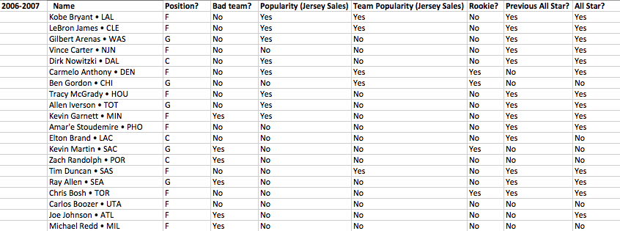
Methods
Dataset and classifiers
ZeroR
OneR
Naïve Bayes
J48 Decision Tree (pre-pruned and post-pruned)

Slide 5
Results
Which algorithm worked the best?

Slide 6
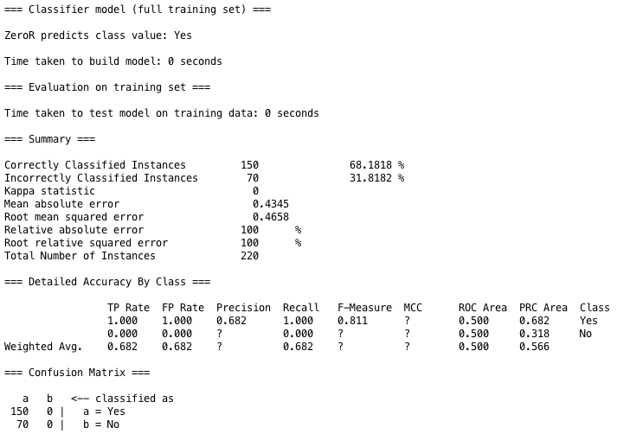
ZeroR results

Slide 7
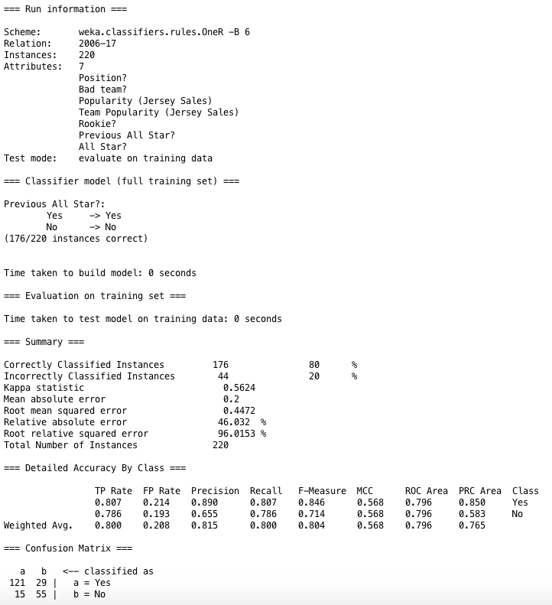
OneR results

Slide 8
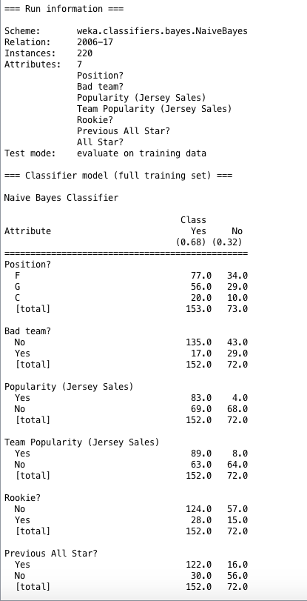
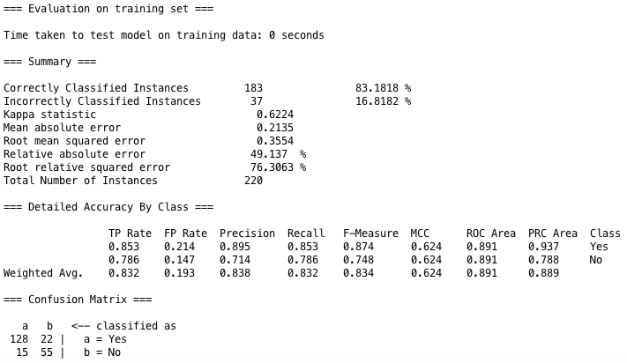
Naïve Bayes results

Slide 9
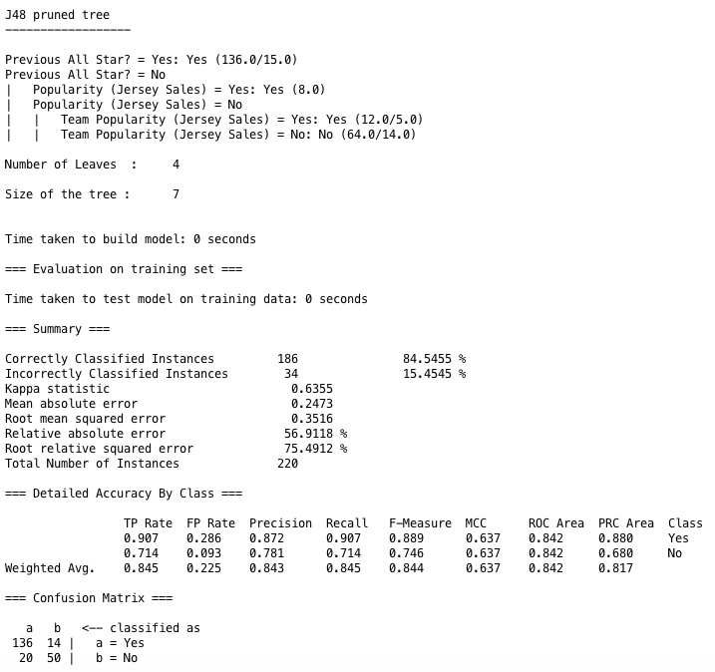
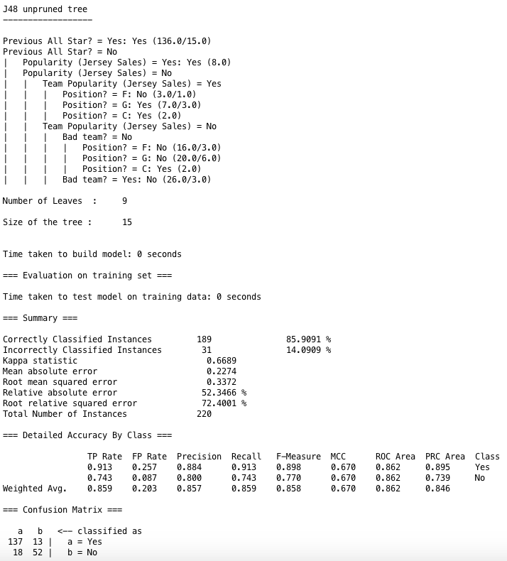
Pre-pruned vs. post-pruned J48 decision tree results
Pre-pruned:
Post-pruned:

Slide 10
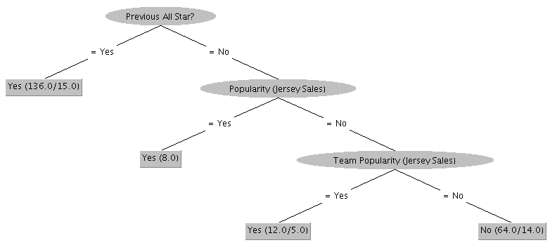
Visualization of pre-pruned J48 decision tree

Slide 11
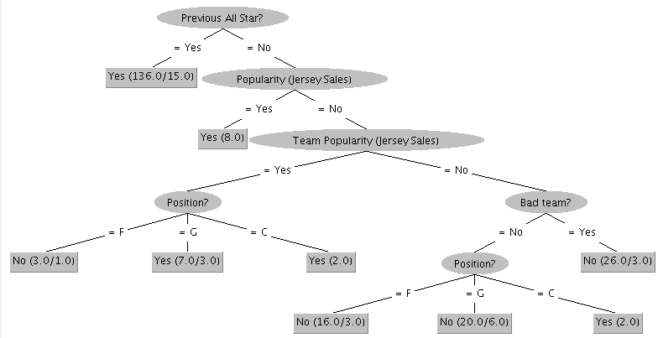
Visualization of post-pruned J48 decision tree

Slide 12
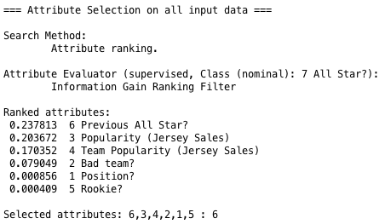
Information gain ranking between classifiers

Slide 13
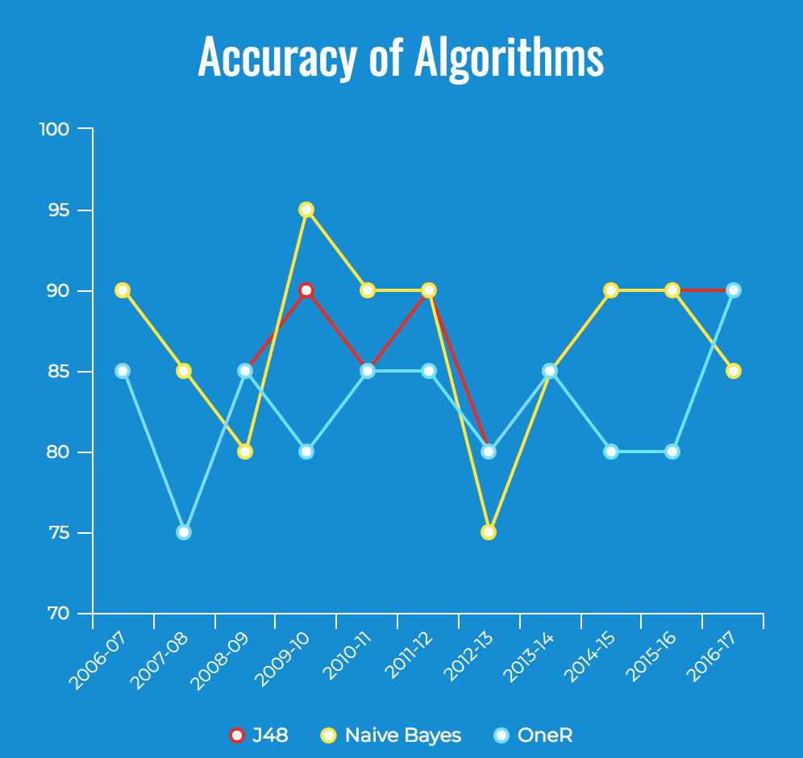
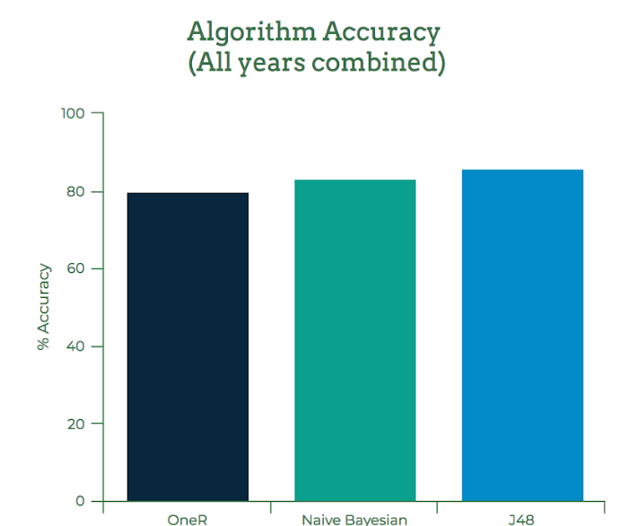
Comparison of Algorithmic Success
(By year)
% Accuracy

Slide 14
Discussion
J48 post-pruned
Results of other algorithms
Information gain rank
Can we predict future All-Stars?

Slide 15
Predicting Future All-Stars
Use the information on the following slide to predict the NBA All-Stars of 2017-2018

Slide 16
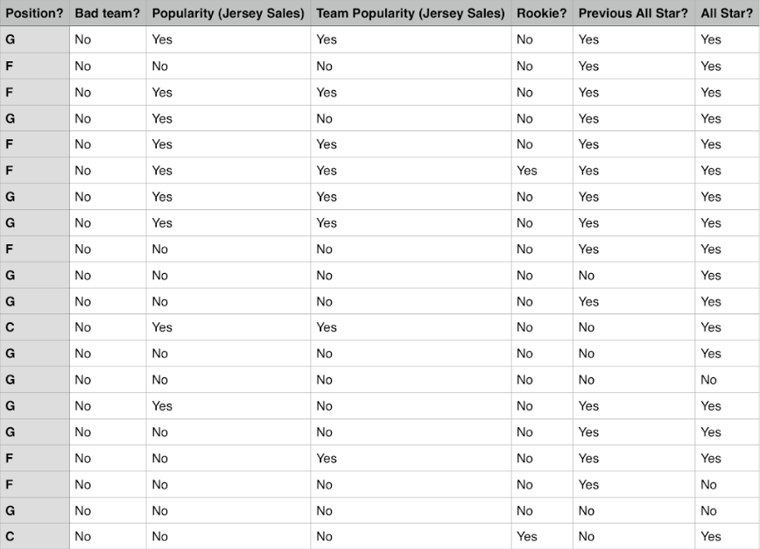
Yes
Yes
Yes
Yes
Yes
Yes
Yes
Yes
Yes
No
Yes
Yes
No
No
Yes
Yes
Yes
No
No
Yes
90% Correct
Classification!

Slide 17

Thank you for listening!

